Slide 2
Notes:
Brian Tarallo Managing director of Lizard Brain Solutions.
I have some folks from the lizard brain network here today: Heather Lynn, Caryn, Erin, Lisa. When we do breakouts, please seek them out if you have questions.
Graphic Facilitator
What is a graphic facilitator? A graphic facilitator is someone who uses visual tools to help groups get from where they are to where they want to be. Equal parts facilitator, consultant, and artist. Who knew that was a thing? I’ve been doing this since 2009, and I honestly believe I have the best job in the world.
One thing you need to know about before we jump into it. I care very deeply about these things I’m going to talk to you about, and sometimes that shows up as energy. So if I seem like I’m emotional, I am, it’s just that it’s not about you.
4 kids that go to nysmith

Slide 3
See and try techniques for virtual facilitation
Technologies
Best practices
Harvest the knowledge in the “room”
Notes:
Learning objectives
…and there will be prizes for correct answers.

Slide 4
You can choose to be on CRUISE CONTROL or TAKE THE WHEEL
Watch and observe OR try things out
We’re going to be switching between different tools and windows
It might be clunky!
We’re going to be on the BALCONY and the DANCEFLOOR
Others…?

Slide 5
House-keeping
Can you hear/see?
If booted out, dial/click back in
We are recording
Mute when not talking:
To speak, you can click “Unmute” or hit *6 on your phone
You’ll be on mute by default
Use chat to ask questions and get links
In the upper right, there’s Speaker View and Gallery View.

Slide 7
Please check your chat window for a link to BoardThing:
https://boardthing.com/board/5a3969a0af0a2c060f798aab
You do NOT have to register: select enter as guest
Double-click anywhere in the white space to create a sticky note
Type your NAME and what you CALL YOURSELF (Facilitator? Instructor? Consultant? Etc.)

Slide 9
Please check your chat window for a link to this Google Doc:
https://docs.google.com/document/d/1xJCMToZ56_ADz9VYAHs2MBc4QB3Bl1hDMQJhjEcC-O4/edit?usp=sharing
Type anywhere in the bulleted list:
“How do you define virtual facilitation?”
Add a new bullet for your answer, and try not to type on top of each other’s lines.

Slide 10
Poll: how much virtual facilitation do you do?

Slide 11
Go to this link (in chat): https://docs.google.com/spreadsheets/d/1CTOu9e75RqUykTo36hO9DcahGdMQHKPzvHd0hFpki50/edit?usp=sharing
Write PROBLEMS you’ve seen or had with virtual facilitation
Write POSSIBLE SOLUTIONS for those problems on the same row

Slide 12
On your smartphone, go to www.menti.com and use code 59 34 94
No smartphone? Open a web browser and do the same.
No web browser? You’re hopeless. I can’t help you.

Slide 13
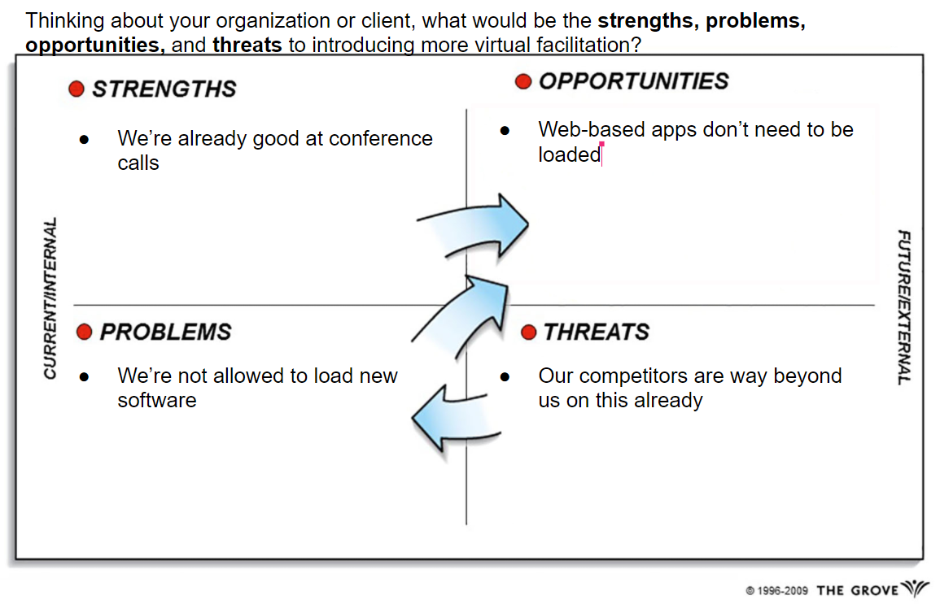
Go to this link (in chat): https://docs.google.com/presentation/d/1E70ttPzszPlDY2f3aihICTZZhau-Soqovmtz9adwIS8/edit?usp=sharing
Answer:
Thinking about your organization or client, what would be the strengths, problems, opportunities, and threats to introducing more virtual facilitation?

Slide 14
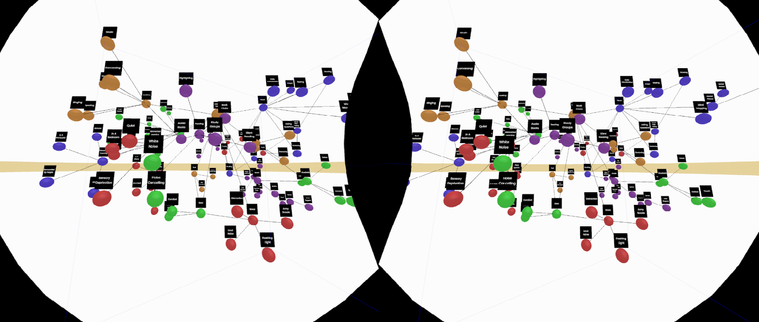
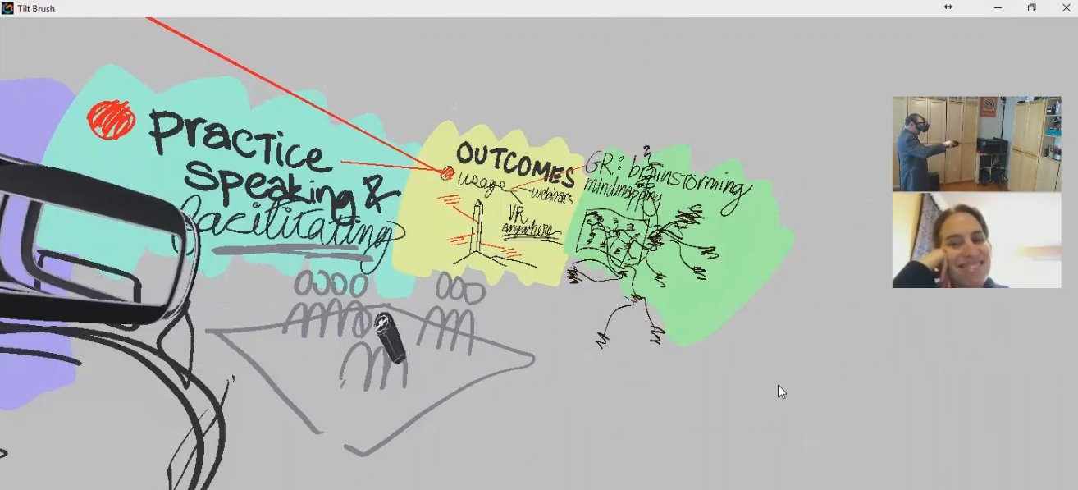
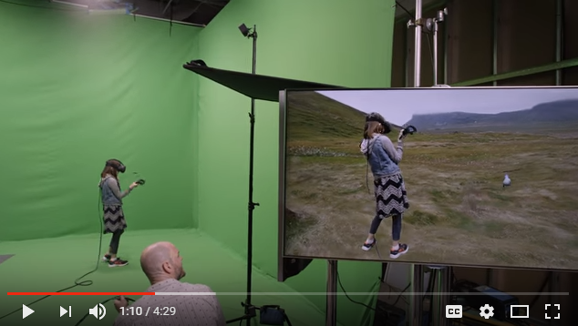
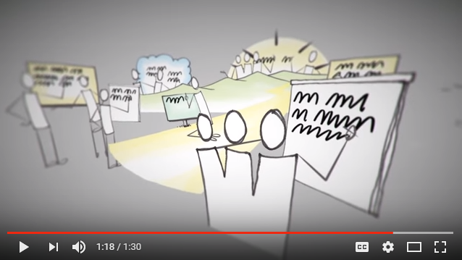
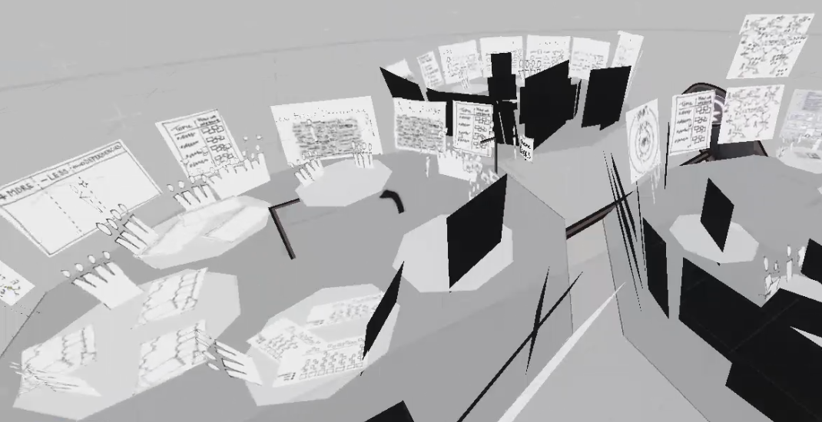

Slide 15
Go to this link (in chat): https://docs.google.com/spreadsheets/d/11-srN2HwS_NrnXPzastiCthYj-Zu3sPmi9VusOuf4Js/edit?usp=sharing
In each row, type:
The name of a virtual facilitation tool you use
What it does
The cost (if you know it)
Pros (if you want)
Cons (if you want)
Don’t worry about duplicating work

Slide 16
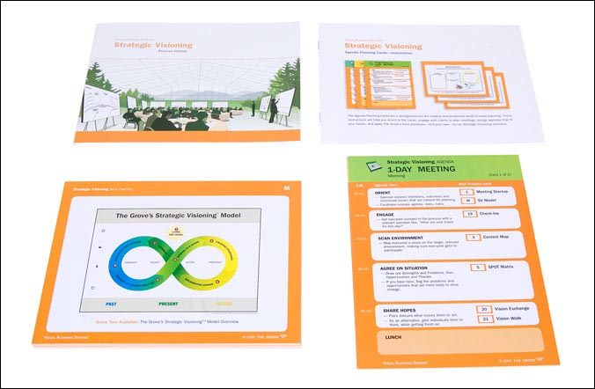
Class: Virtual Team Facilitation
The Grove Consultants, Rachel Smith
TeamCatapult, Marsha Acker
https://teamcatapult.com/workshops/virtual-team-facilitation/
Class: Facilitating Virtual Collaboration
The Grove Consultants, Rachel Smith
http://www.grove.com/workshops_facilitatingVirtualCollaboration.php
Rachel Smith’s blogs
http://news.grove.com/author/rachelsmith/
http://digitalfacilitation.net/
Visual Templates
Grove’s Strategic Visioning templates
https://grovetools-inc.com/collections/digital-graphic-guides-v-4-0
Think With Ink
http://lizardbrainsolutions.com/think-with-ink/
Me! brian@lizardbrainsolutions.com

Slide 17
On your smartphone, go to www.menti.com and use code 90 14 42

